Slide 2


Analysis of FPAs in the LHC RB circuit
Christoph Obermair, TE-MPE-CB Lukas Felsberger, TE-MPE-MI Franz Pernkopf, TU-Graz Andrea Apollonio, TE-MPE-CB Daniel Wollmann, TE-MPE-CB
Acknowledgement:
SIGMON-Team: Signal Monitoring Project: https://sigmon.web.cern.ch/
STEAM-Team: Simulation of Transient Effects in Accelerator Magnets: https://espace.cern.ch/steam/

Slide 3
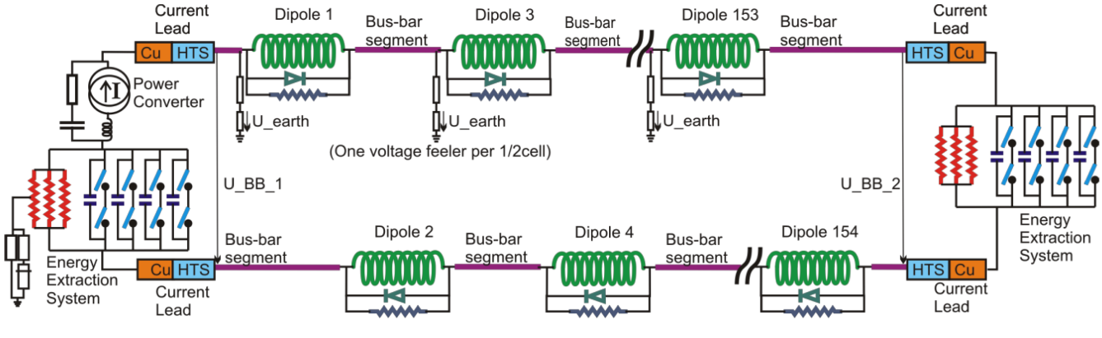
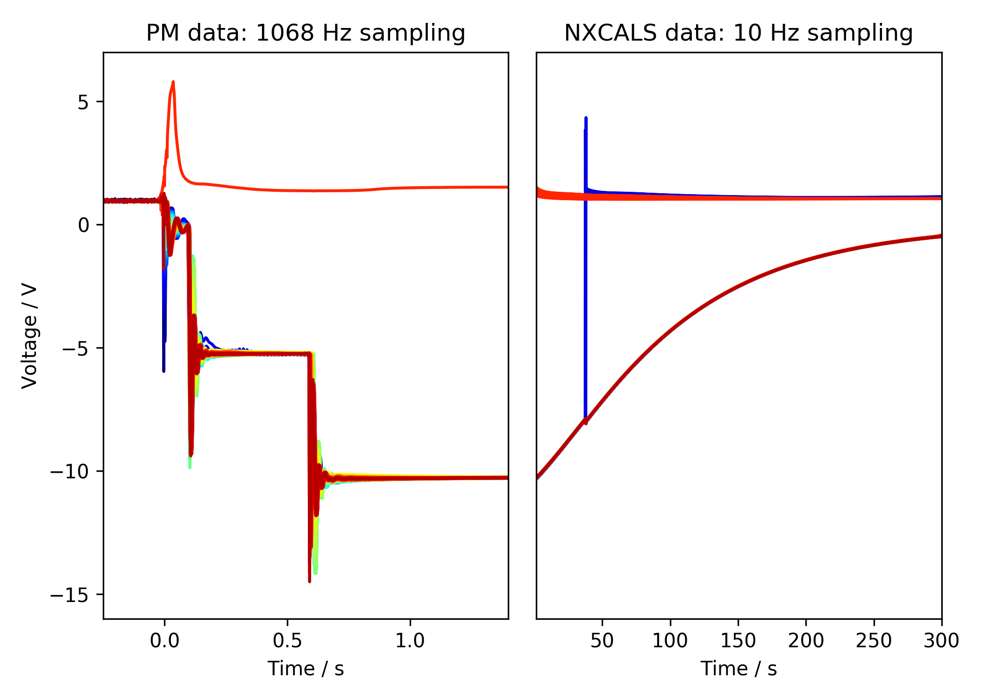
RB Frequency Analysis
Goal: Use data to better understand frequencies in RB circuit to:
Improve PSPICE simulations from MPE-PE STEAM-Team
Detect deviations from what is expected
1st EE
Plateau
2nd EE
Plateau
2nd EE switch off
Secondary quench
1st EE switch off
PC Switch off
Event:
RB_RB.A78_1617170255140000000 2021-03-31 07:57:35.120000 Primary Quench at el. Position 141

Slide 4
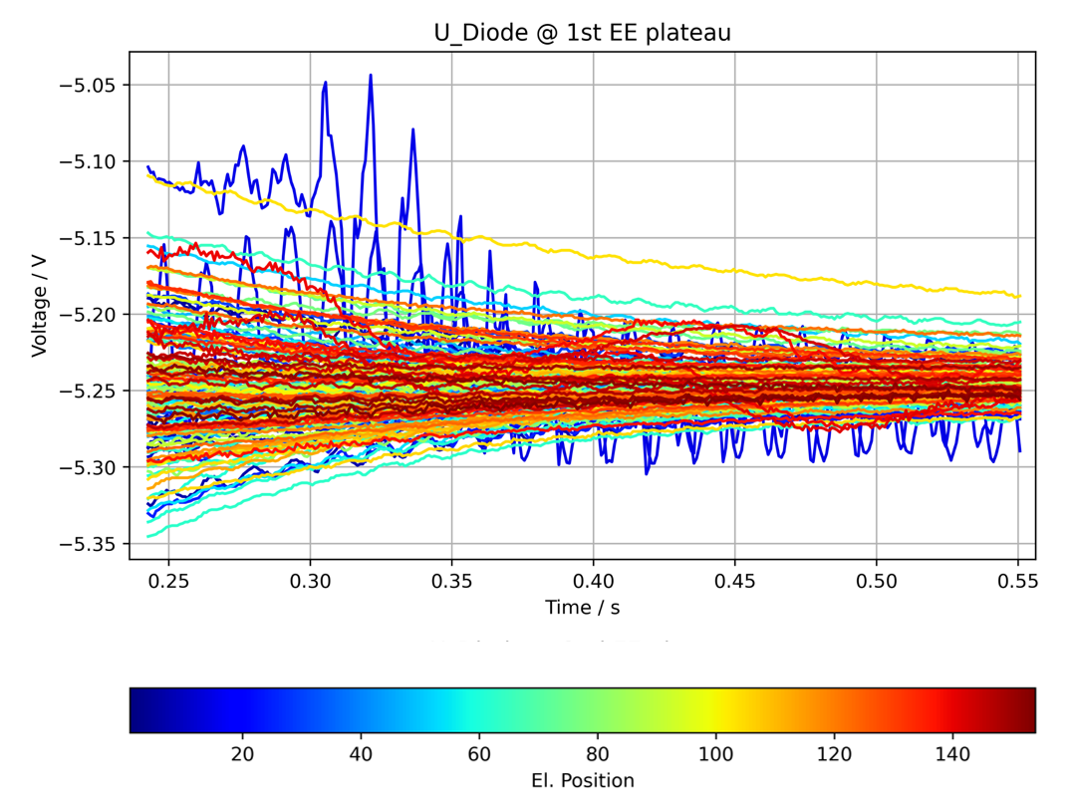
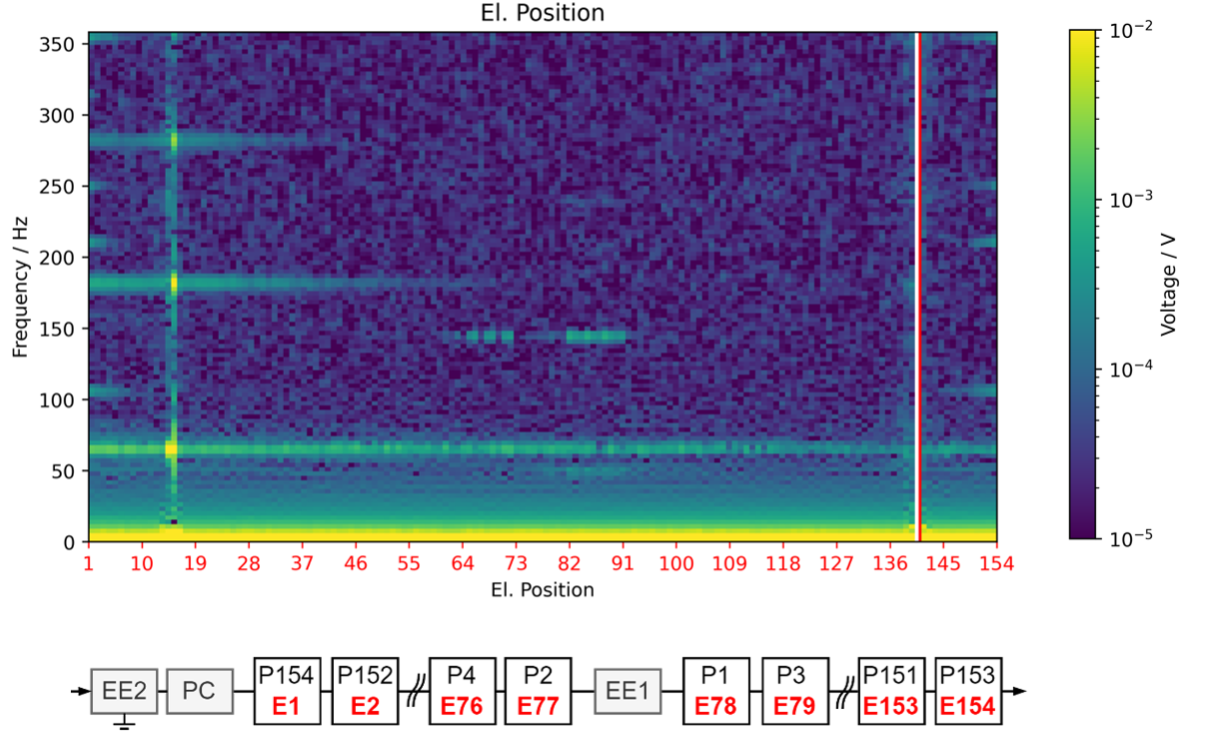
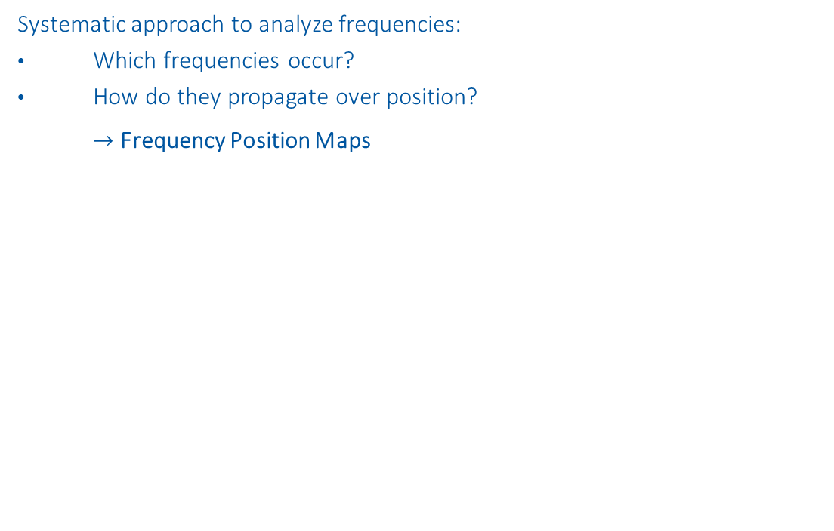
RB Frequency Analysis
Systematic approach to analyze frequencies:
Which frequencies occur?
How do they propagate over position? $→$ Frequency Position Maps
fft
Event:
RB_RB.A78_1617170255140000000 2021-03-31 07:57:35.120000 Primary Quench at el. Position 141

Slide 5
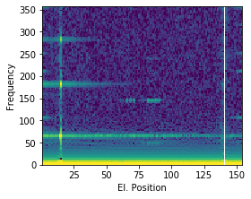
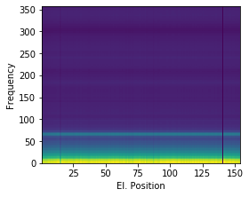
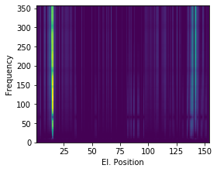
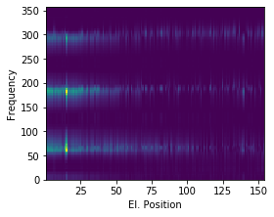
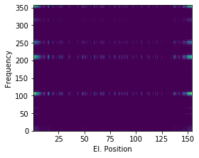
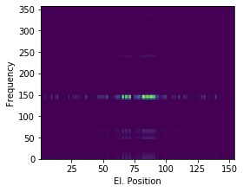



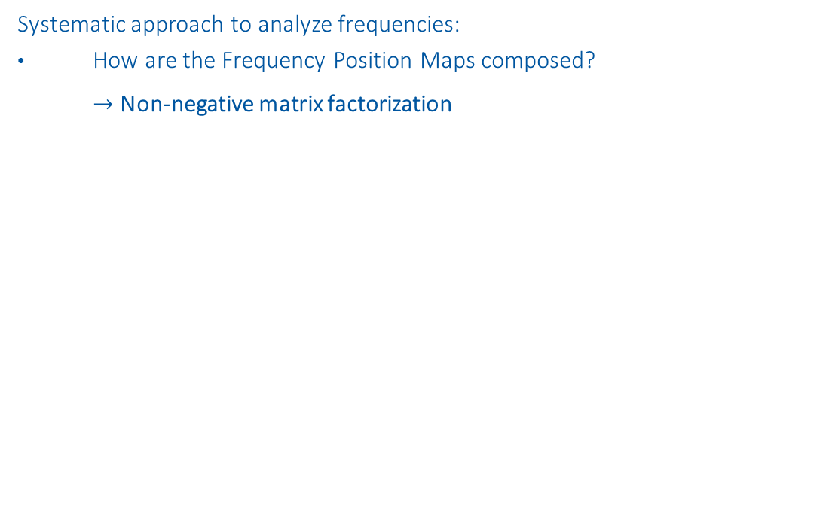


RB Frequency Analysis
Systematic approach to analyze frequencies:
How are the Frequency Position Maps composed? $→$ Non-negative matrix factorization
$$≈$$
$$+$$
$$+$$
$$+$$
$$+$$
Common Oscillation
Physical Propagation
Electrical Propagation
Power Converter
Energy Extraction
Event:
RB_RB.A78_1617170255140000000 2021-03-31 07:57:35.120000 Primary Quench at el. Position 141

Slide 6
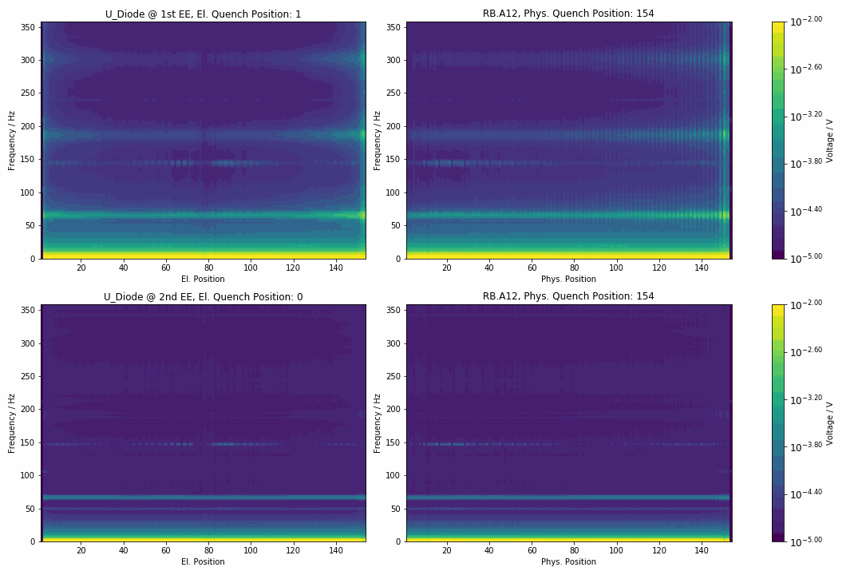
RB Frequency Analysis
Systematic approach to analyze frequencies:
What are the expected frequencies depending on a quench?

